Slide 1

Recognizing & Addressing Global Health Malpractice
Slide deck by @paimadhu

Slide 2
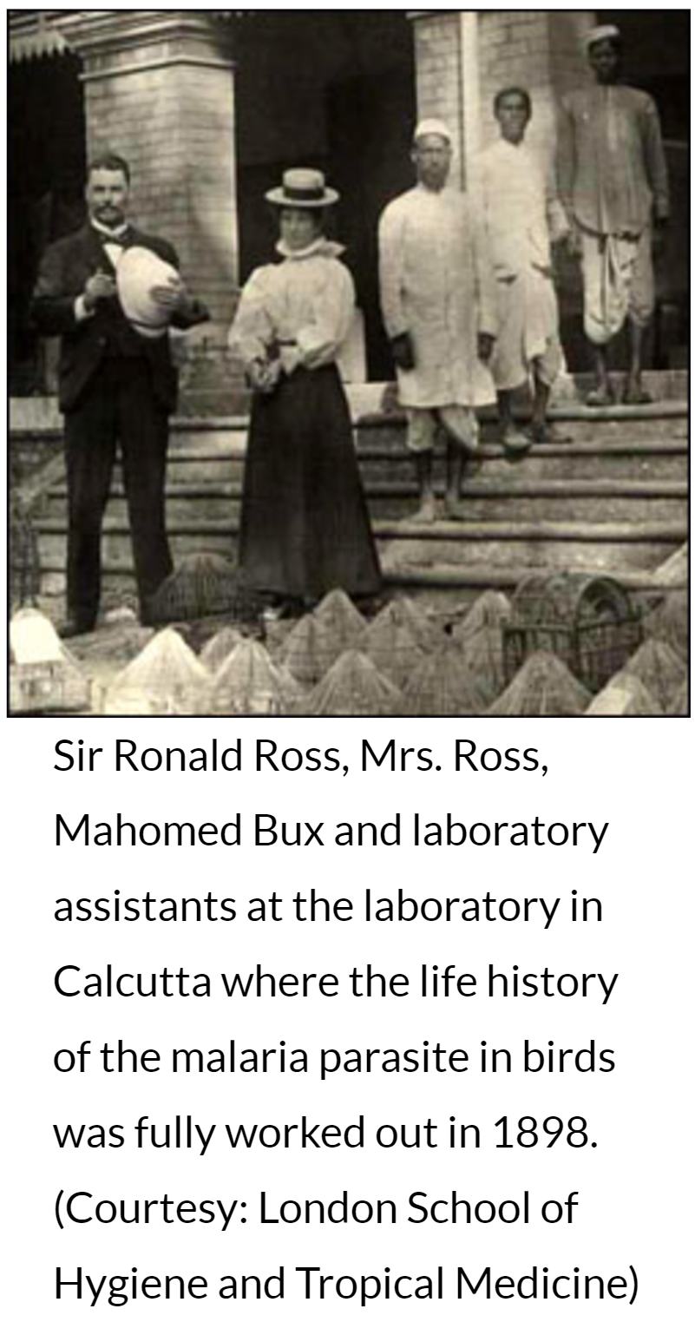
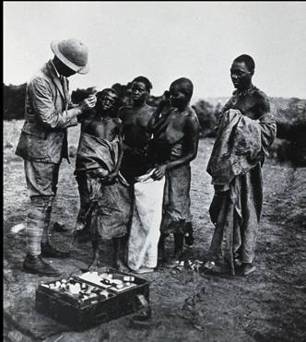
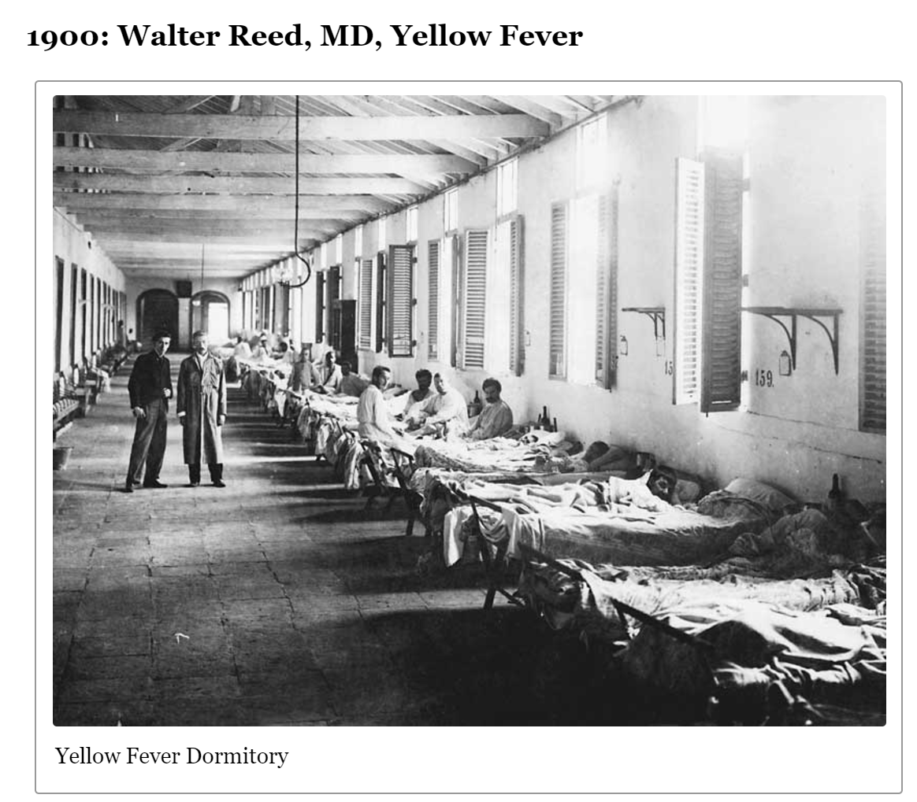
Historical origins of global health
Colonial medicine
Missionary medicine
Military medicine
Tropical medicine
International health
Global health

Slide 3
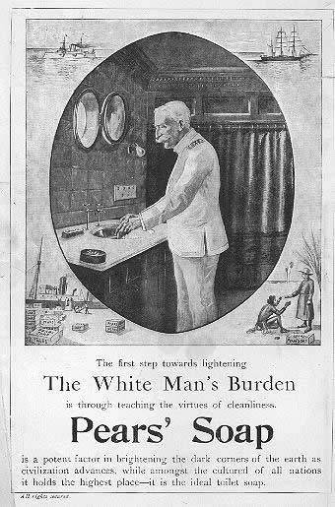
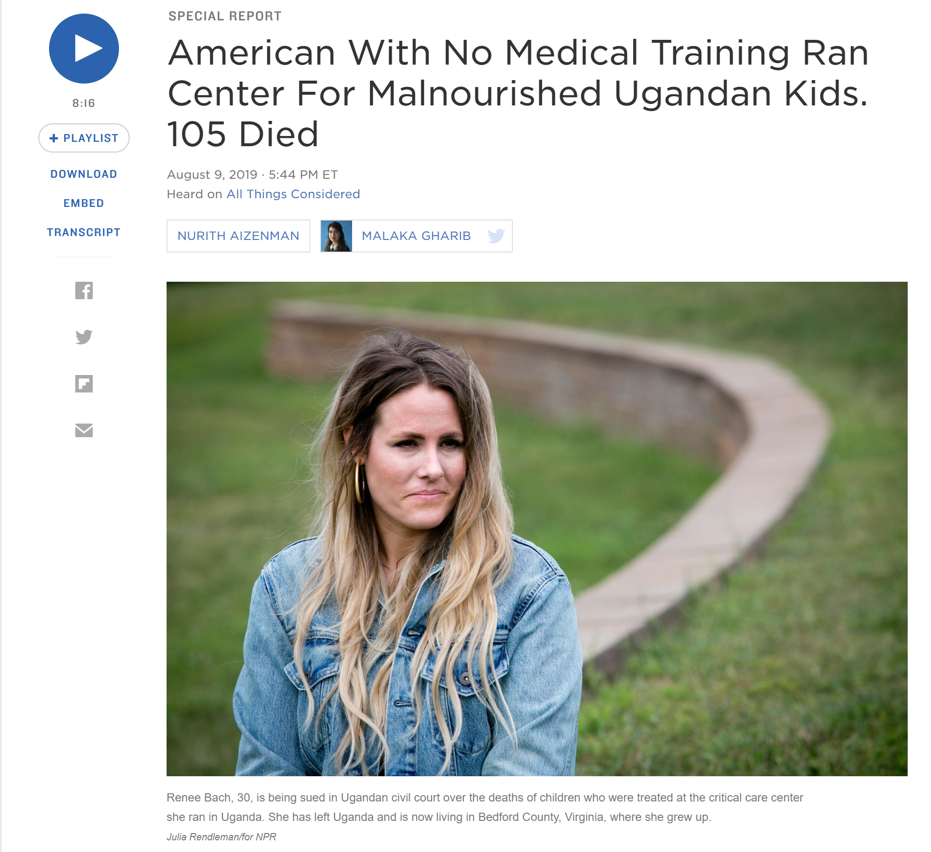
The White Savior Complex

Slide 4
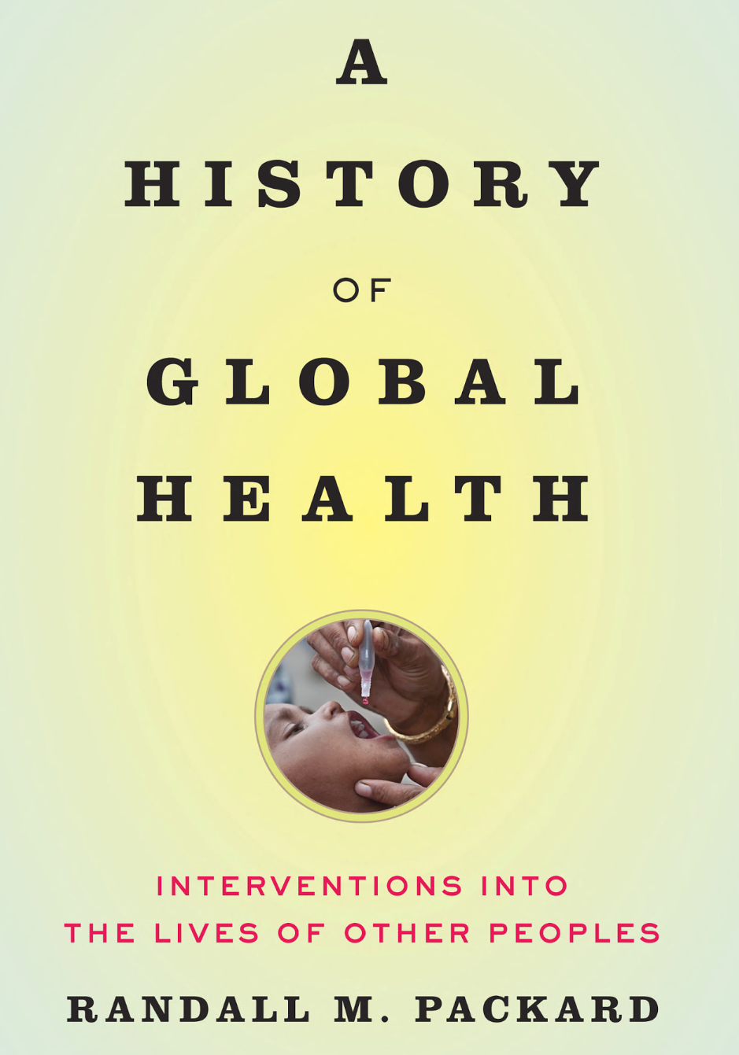
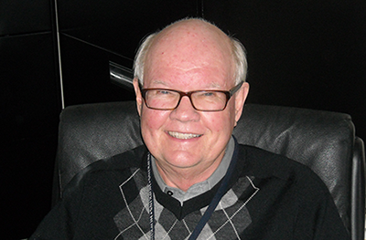
“…at its core, (global health) history remains predominantly about flows of goods, services, and strategies along well-trod, north-south pathways.”

Slide 5
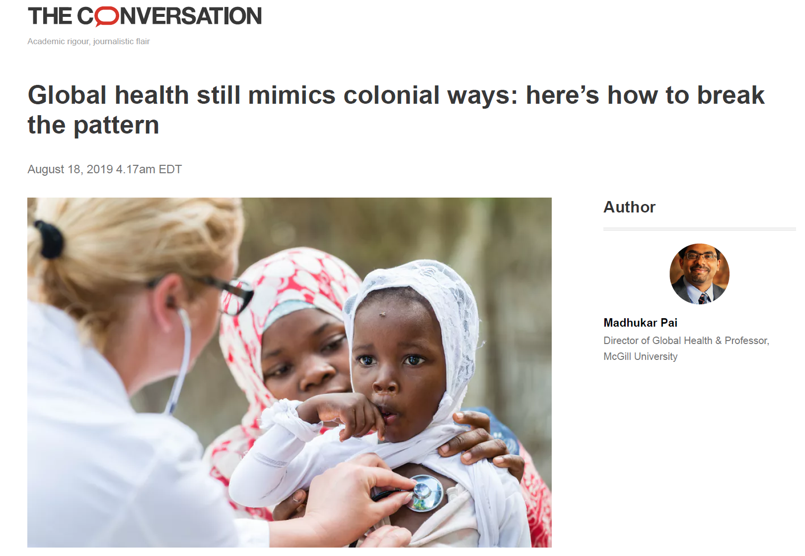
https://theconversation.com/global-health-still-mimics-colonial-ways-heres-how-to-break-the-pattern-121951

Slide 6
https://www.globalhealthnow.org/2019-08/10-fixes-global-health-consulting-malpractice

Slide 7
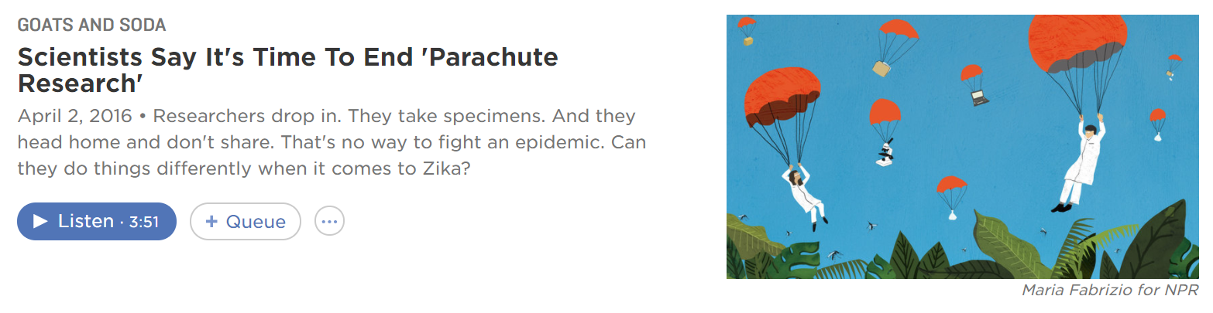
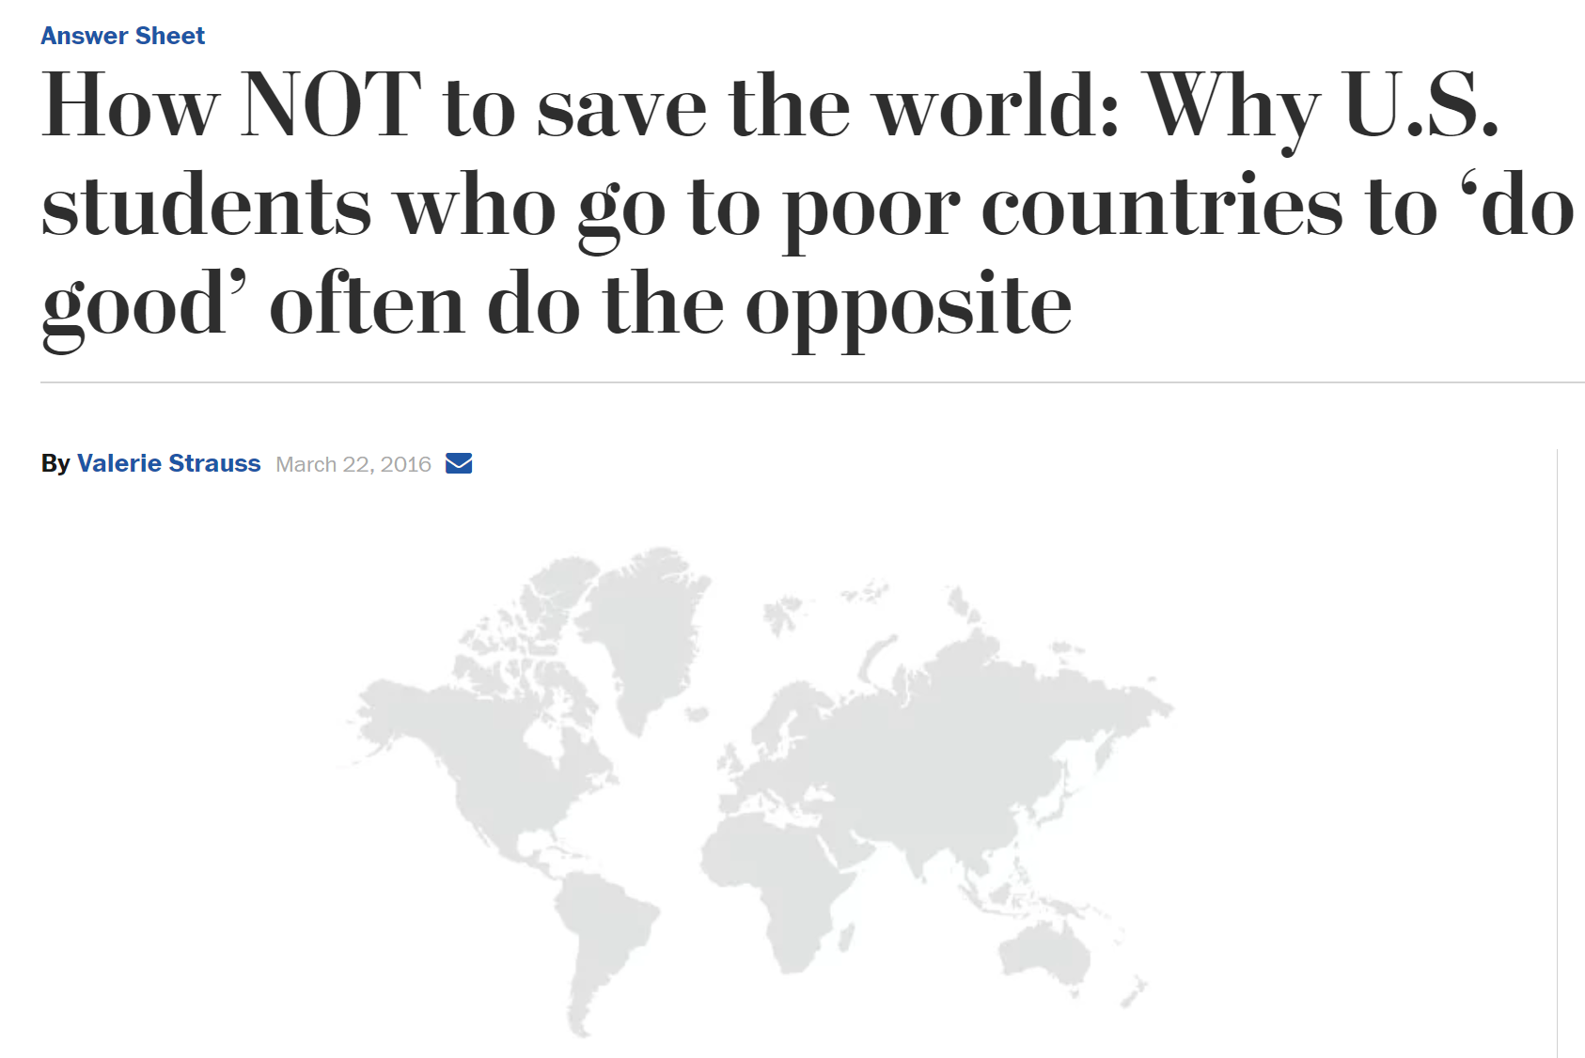
1. Avoid global health voluntourism
Global health courses must discourage global health voluntourism, and guide trainees and graduates on what they must NOT do, when they go to LMICs. How NOT to save the world must be a critical, required component of all global health courses. The principle of do not harm must be reinforced in all training.

Slide 8
2. Learn about colonial history before doing global health
Those studying or working in global health must complete a course or book on the colonial history of tropical, international and global health.

Slide 9
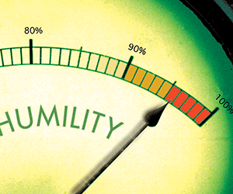
3. Enhance predeparture training
Predeparture training by global health programs must also include content on cross-cultural effectiveness and cultural humility, bidirectional participatory relationships, local capacity building, long-term sustainability, and respect for local expertise and leadership. Training in allyship and privilege is also critical. Above all, HIC trainees and experts must learn to listen and be humble.

Slide 10
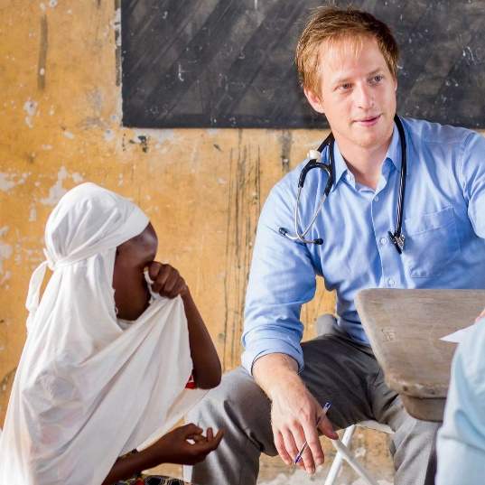
4. Consultants must have lived/worked in LMICs
Consultants must have lived and worked in LMICs, preferably, in the same countries they will be advising. A 2-week trip to South Africa does not make anyone an “Africa expert.” As Randall Packard put it, “Everyone involved in global health decision-making should be required to work in the countries and see how things look from the ground level.”

Slide 11

5. Consultants should stay within their expertise
Consultants should be careful about going beyond their specific content or country expertise. It is perfectly fine to decline consulting invitations that are a poor match with skillsets or country-specific experience.

Slide 12
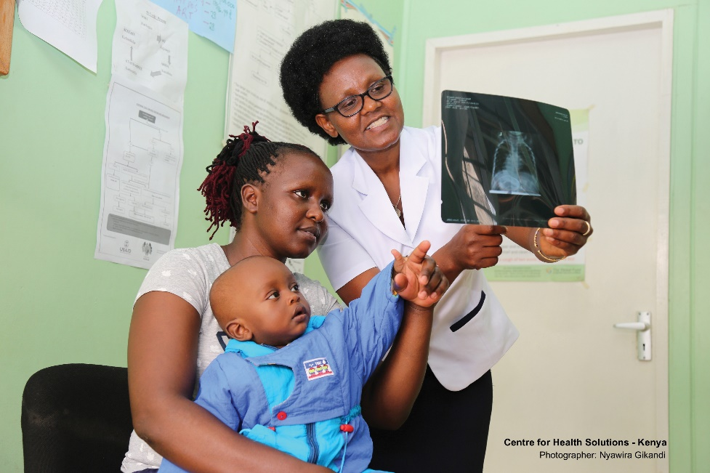
6. Consult, before offering technical assistance & tap into local expertise
Before technical assistance is offered, ministries of health in LMICs should be consulted on what specific expertise and prior experience/background they need. If there are local experts who are suitable, they could be contracted to provide technical assistance instead of expensive consultants flown in from HICs.

Slide 13

7. Strengthen global health capacity in LMICs
Strengthening global health capacity in LMICs and expanding the cadre of national experts is key for weaning LMICs away from the current dependence on HIC experts. This is an opportunity for HIC institutions to demonstrate reciprocity. Schools of public health and research institutions in HICs have an obligation to host, train and send back talented LMIC researchers and experts.

Slide 14





8. Enhance good training and capacity development in LMICs
Building top-notch schools and institutions in LMICs and developing world-class expertise within them is key to reduce reliance on consultants from HICs.

Slide 15
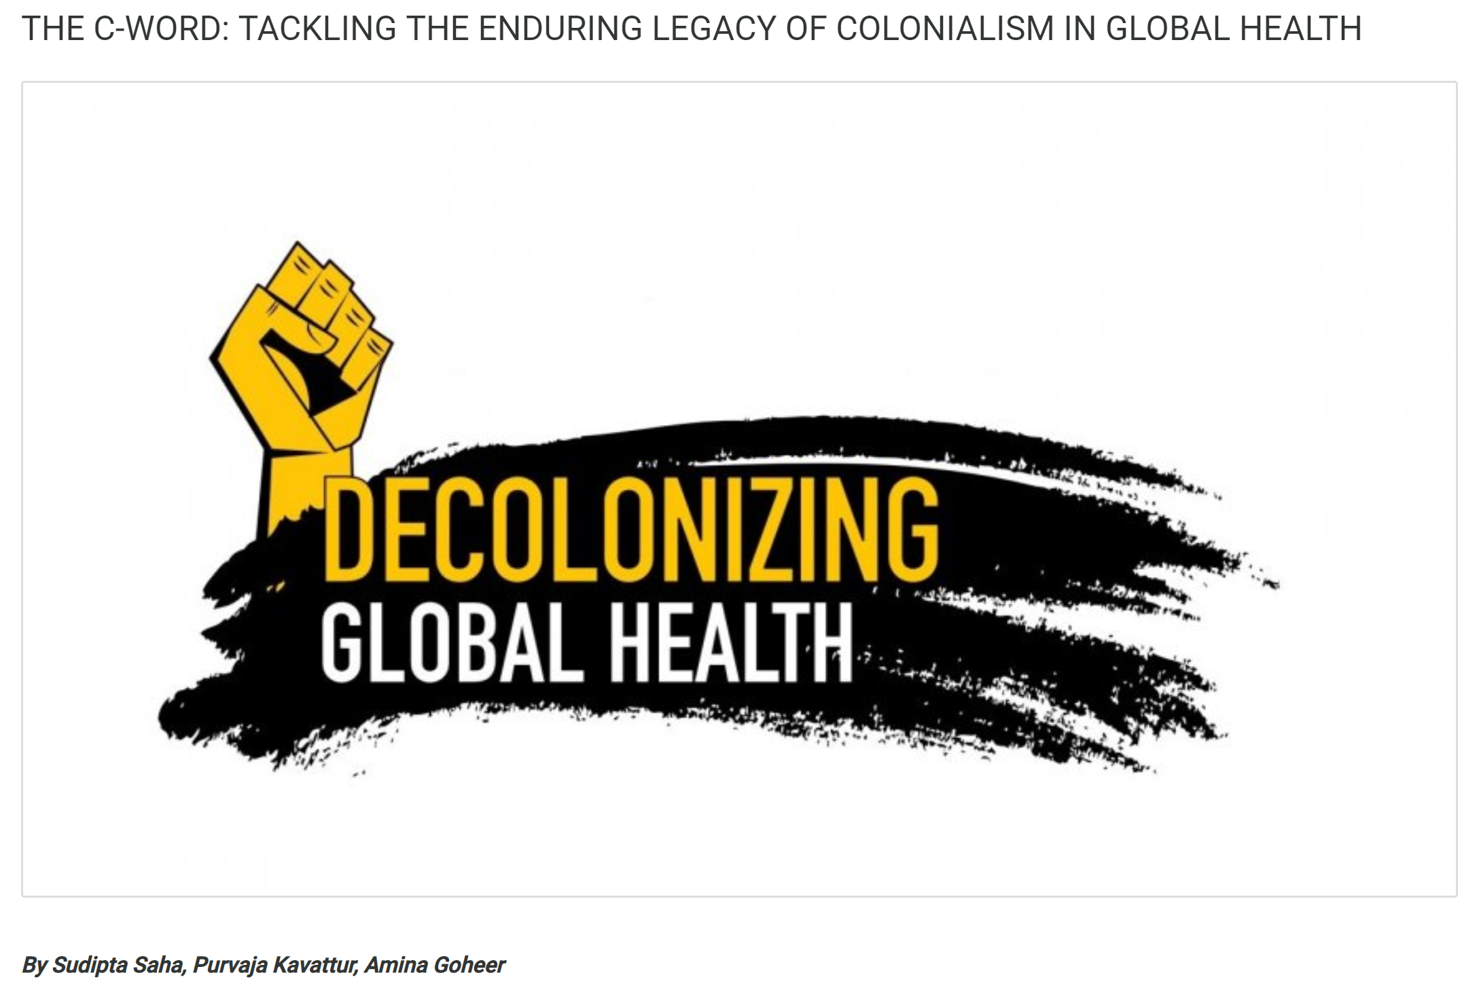
9. Work towards decolonizing global health
The ultimate solution is to challenge the current architecture of global health and work towards “decolonizing global health.” This includes answering uncomfortable questions. Why are global health institutions, donors, and power structures invariably based in HICs or controlled by HIC experts? Why is the flow of funding, people and knowledge unidirectional (North to South)? What colonial practices have led to the heavy dependence of LMICs on aid and technical assistance from their former colonizers? Why are major decisions in global health made in Geneva, Davos, New York or Seattle when those who deal with the real issues and have solutions are not at the table? And why are global health meetings held in HICs when the real problems and expertise are elsewhere?
https://www.healthsystemsglobal.org/blog/341/The-C-Word-Tackling-the-enduring-legacy-of-colonialism-in-global-health.html

Slide 16
10. Rethink the entire global health consulting industry
When strong global health leadership emerges from LMICs, the role of external consultants will need to evolve. HIC experts will have to see themselves as enablers not “fixers.”
“I hope that we can begin to truly decolonize global health by being aware of what we do not know, that people understand their own lives better than we could ever do, that they and only they can truly improve their own circumstances and that those of us who work in global health are only, at best, enablers.”
Seye Ambimbola
https://academic.oup.com/inthealth/article/10/2/63/4924746

